Slide 1
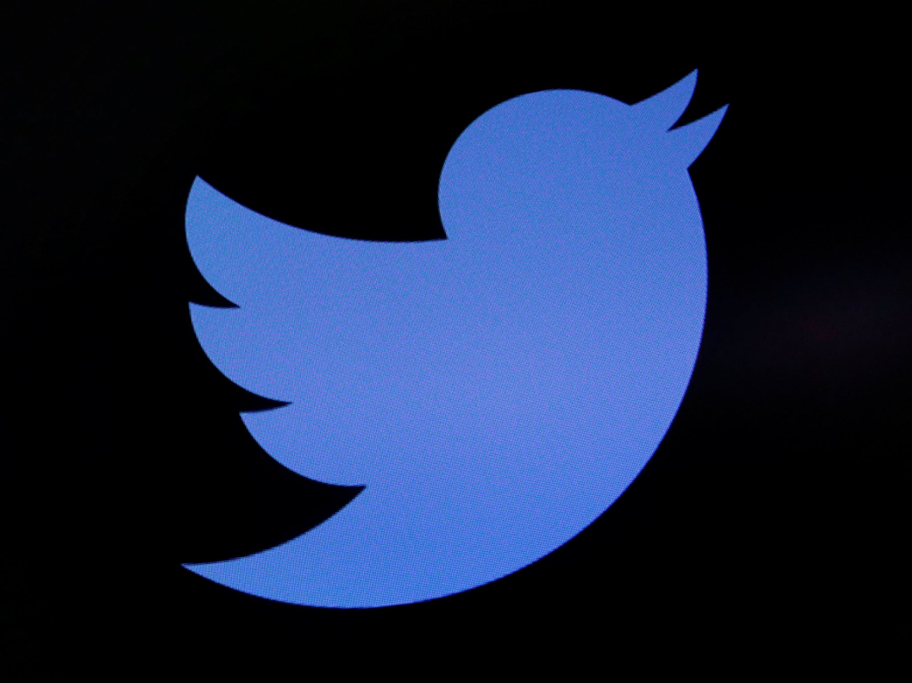

SENTIMENT ANALYSIS FOR STIMULUS CHECK
USING TWITTER SCRAPING
Group 13:
Ami Thakkar
Sagar Pathak
Satish Pinnuri
Notes:
Helo Everyone..We r group 13 & Im Sagar P…
Im Here to give u an introduction about our ptoject Seniment analysis for stimulus check using twiter scarping

Slide 2
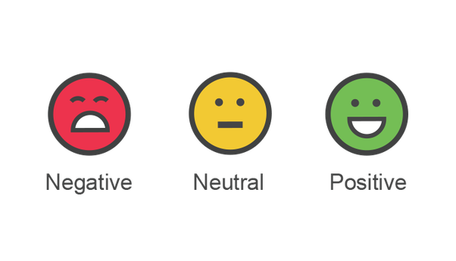
Introduction
Stimulus Check: Intended to balance the economy by providing consumers with spending money.
IRS announced on April 8 to send electronic payments to 115 million Americans due to COVID-19
The goal is to categorize the tweets into Positive, Negative and Neutral opinions using Sentiment Analysis and make an inference
Notes:
Coming to Introduction
As we all knkow about covid 19 pendamic and its impact on economy.
The government had taken an iniciative to ptovide stimulus check to all the eligible us citizens on April 9th .
Now the goal of our project is to analyze people’s sentiment for this initiative
To implement this project we have considered scraping twitter data

Slide 3

Why Twitter?
One of the most popular social media platforms.
Easily available public opinions and statements.
Most suitable platform for sentiment analysis.
Notes:
Why twitter
Twitter is the most popular socil media platform where there is liberty to share our personal opinions and thoughts.
Hence, we have considered Twitter as the most suitable platform to perform the sentiment analysis.
Let’s know more about data in the next slide.

Slide 4

Data Extraction
Data size is set to 15000 in the form of an array of arrays
Data consists of Date, Time and related tweets
Extracted data for 3 timelines:
1.04/12/2020 – 04/15/2020
2.04/20/2020 – 04/23/2020
3.04/29/2020 – 05/01/2020
Notes:
In data extraction process, we have considered extracting data from twitter for three different time frames.
We have set the dataset size to 15000 records for each time frame.
The collected twitter raw data had variables like: Date & Time of the tweet, tweet text.
We also had unnecessary content in the data which is not required for sentiment analysis.
So, The cleaning process will be explained by my teammate Satish Pinnuri.

Slide 5

Data Pre-processing
Extracted tweets contains distorted data with hyperlinks, symbols, RT (retweet), mentions.
Removed unwanted noise.
Include stop words: stimulus, check, covid19, F***, S**t, got, and, etc.
Selected variables that are required for the analysis.

Slide 6

Methodology
Keyword: #StimulusCheck
Packages:
GetOldTweet3
TextBlob(NLTK)
WordCloud
pandas, re, String
Visualization:
MatPlotLib
Microsoft Excel

Slide 7

Algorithm
Install TextBlob
Get sentiment for the tweets (positive, negative or neutral)
Process tweets
Get tweet percentage
Date | Positive | Negative | Neutral
04/12/2020 - 04/15/2020 | 35.17% | 12.70% | 52.13%
04/20/2020 - 04/23/2020 | 38.04% | 20.57% | 41.39%
04/29/2020 - 05/01/2020 | 40.87% | 23.44% | 35.69%

Slide 8
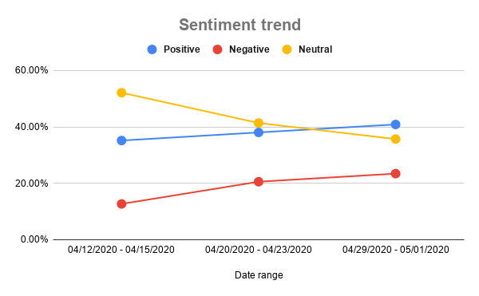

Trend Analysis

Slide 9

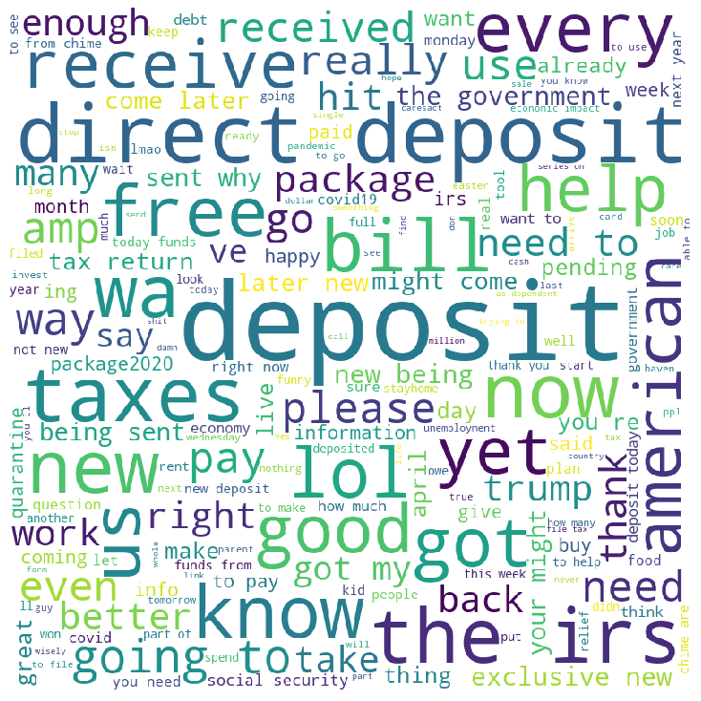
Analysis
Positive word cloud
2020-04-12 to 2020-04-15
Word List:
Deposit
Receive
good
lol
Happy
free
funds
exclusive

Slide 10
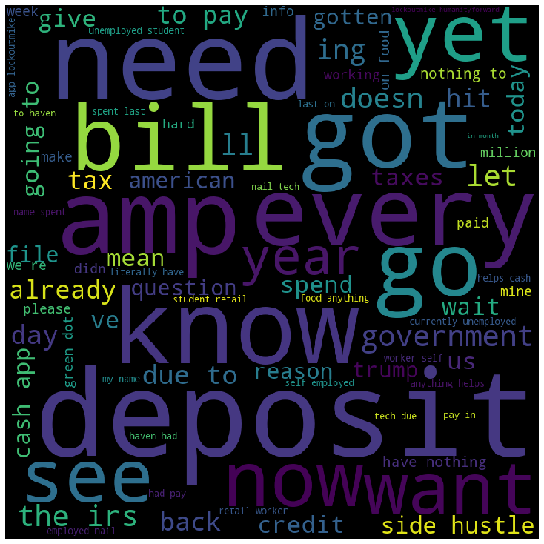
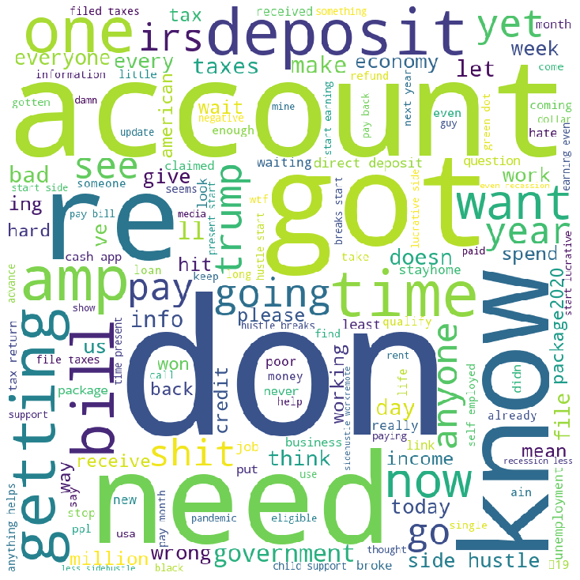
Negative word cloud
2020-04-12 to 2020-04-15
Word List:
Spend
spent last
Unemployed student
currently unemployed
Wait
Question
side hustle

Slide 11
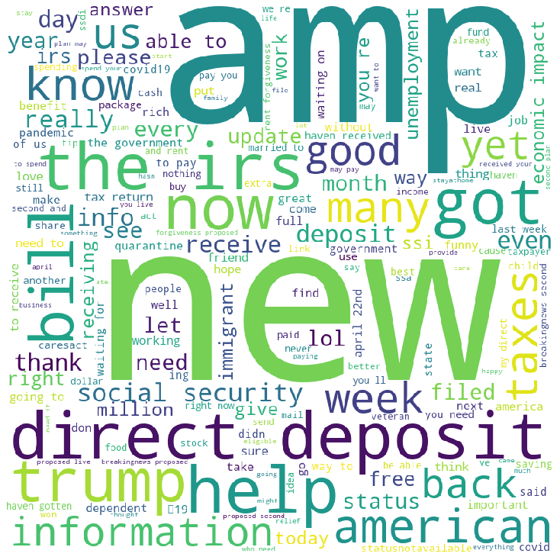
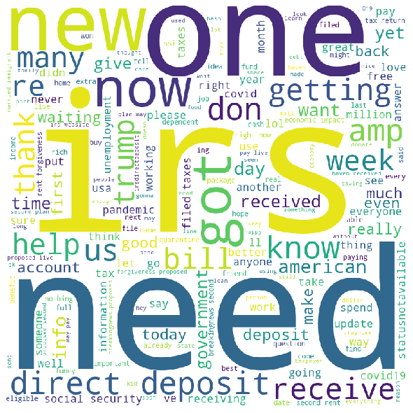
Positive word cloud
2020-04-20 to 2020-04-23
Word List:
Thank
Benefit
love
Rich
Direct Deposit
Information
better

Slide 12
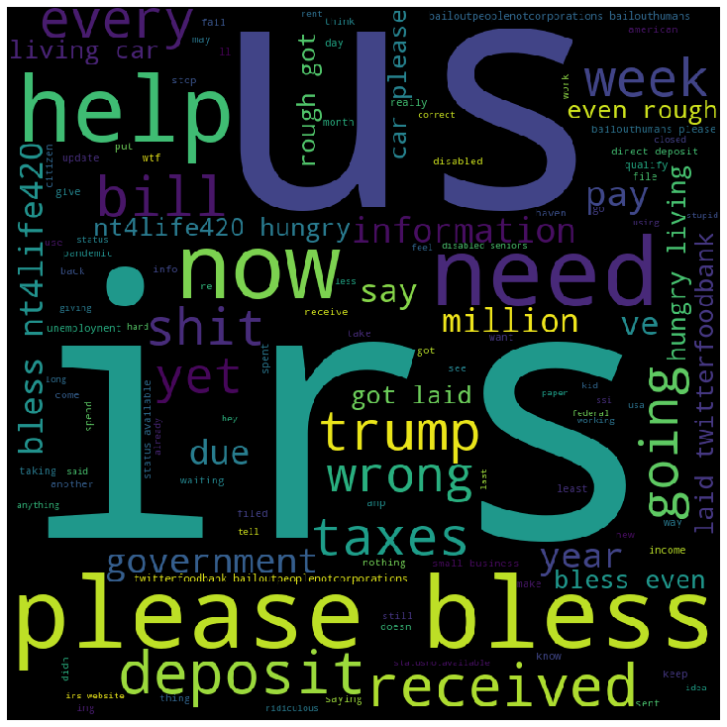
Negative word cloud
2020-04-12 to 2020-04-15
Word List:
even rough
get laid
hungry
disabled seniors
wrong
shit
pandemic
the wrong feel

Slide 13
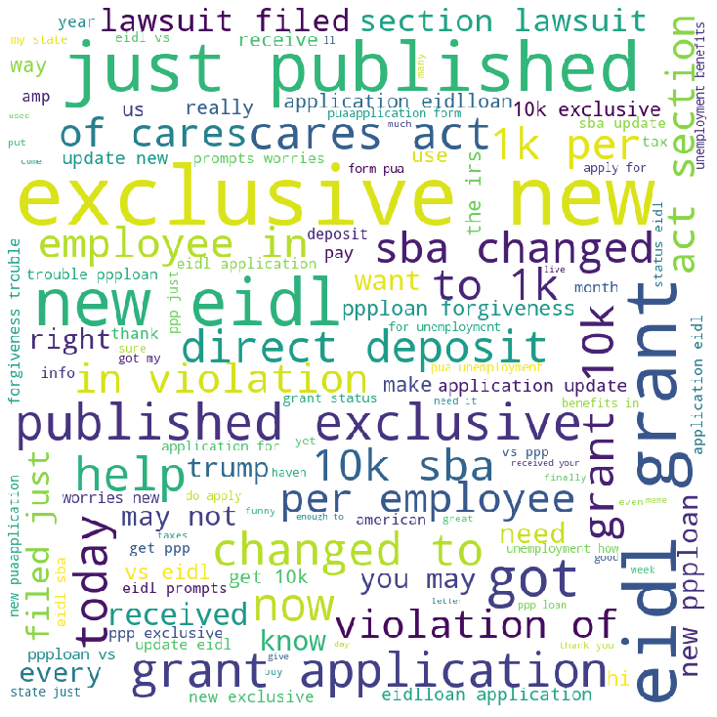
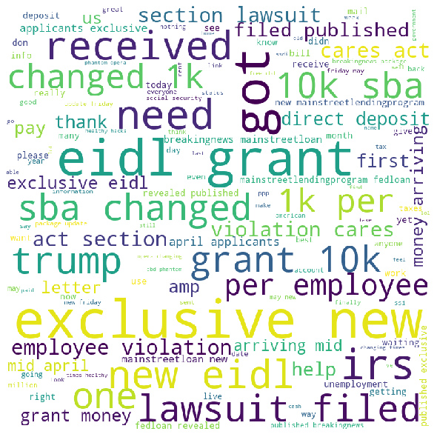
Positive word cloud
2020-04-29 to 2020-05-01
Word list
loan forgiveness
Grant
Care
Thank
Sure

Slide 14
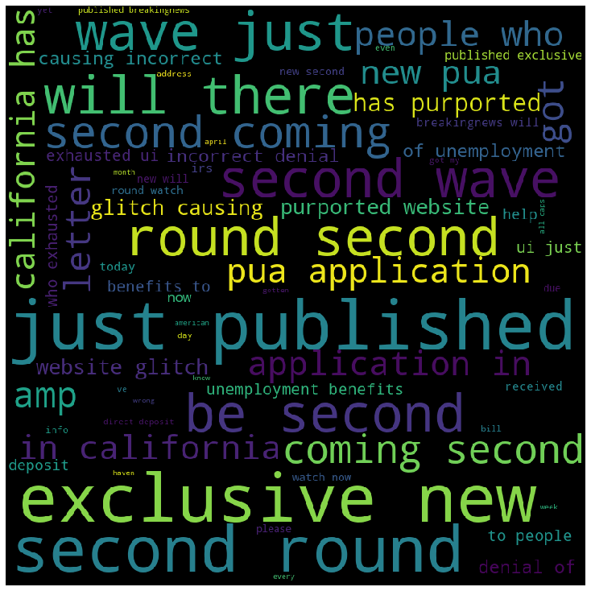
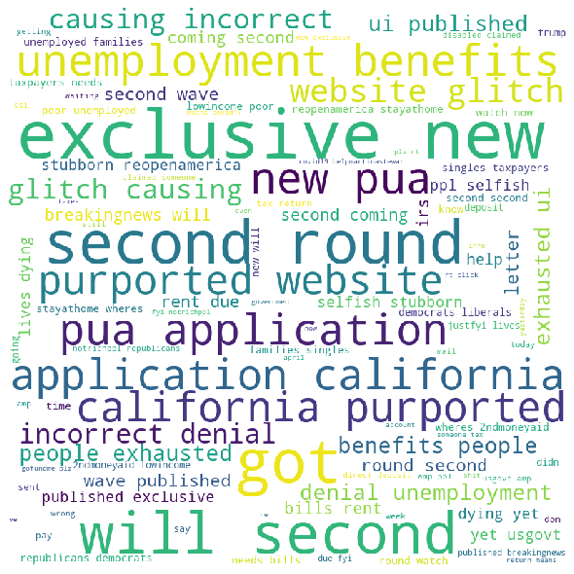
Negative word cloud
2020-04-29 to 2020-05-01
Word List
Second wave
Incorrect
Denial
Unemployment
Website glitch
Exhausted
Wrong

Slide 15

Inferences
Increasing trend in Positive and negative tweets
As time moved forward, people become more informed & aware about the Stimulus check
From trend and WordCloud analysis people are happy with this initiative
People will be extremely happy if the government can issue the second round of stimulus checks.
Notes:
Thank you Ami!
Finally, we are here at the end of presentation.
Here comes the inferences part from the sentiment analysis.
From trend analysis 41% of people are positive and 21% of people are negative to this stimulus check initiative.
From the wordcloud, more positive keywords are been used when compared to negative keywords. Positive Keywords like help, need, Happy, free, food, benefit, thank indicates that this initiative is really helping people who are in need.
Hence, from both the trend analysis and the word cloud we can infer that people are really happy with this initiative and will also be extremely happy if the government can provide the second round of stimulus checks.
Here we conclude the presentation by thanking everyone in this session.

Slide 16
Thank you ☺
Notes:
Thank you Ami!
Finally, we are here at the end of presentation.
Here comes the inferences part from the sentiment analysis.
From trend analysis 41% of people are positive and 21% of people are negative to this stimulus check initiative.
From the wordcloud, more positive keywords are been used when compared to negative keywords. Positive Keywords like help, need, Happy, free, food, benefit, thank indicates that this initiative is really helping people who are in need.
Hence, from both the trend analysis and the word cloud we can infer that people are really happy with this initiative and will also be extremely happy if the government can provide the second round of stimulus checks.
Here we conclude the presentation by thanking everyone in this session.

